Slide 1
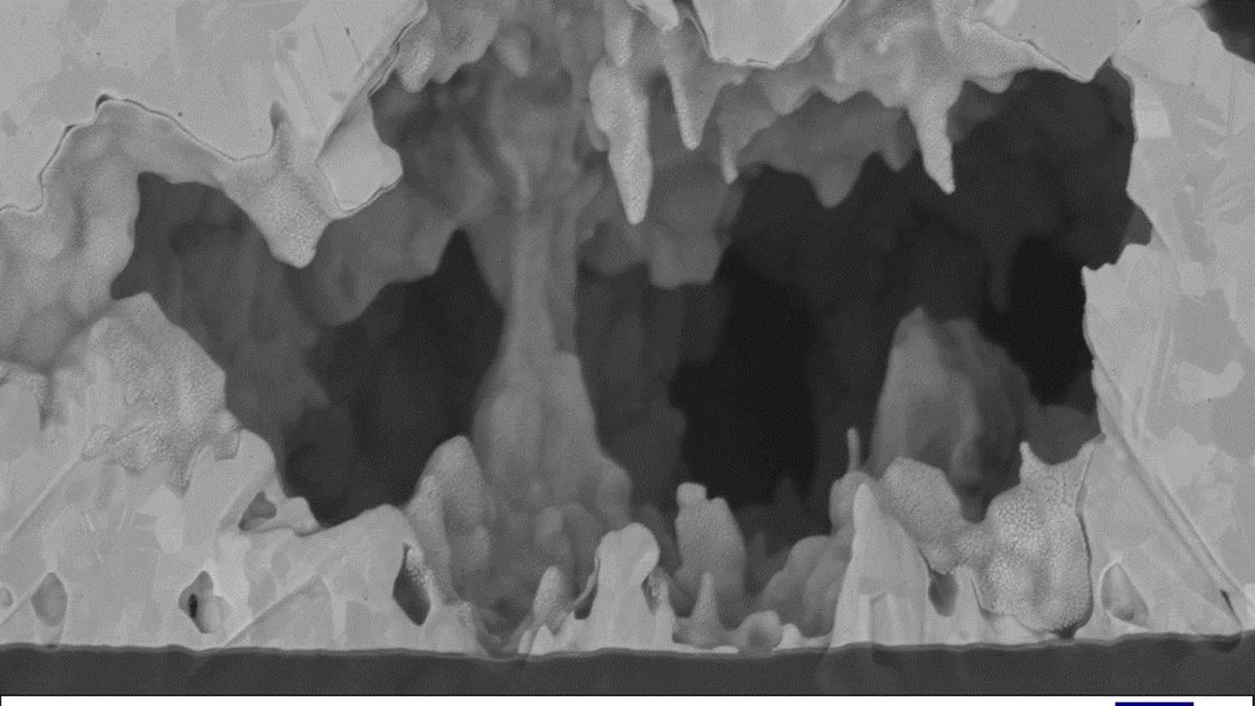
?
Notes:
This is usually the point where you put up a title slide.
But I’ll start with a question to this room full of failure mode experts.
Any one who has seen this before ?
Any one knows what we are looking at ?

Slide 2
Let’s zoom out and add some dimensions
  Gold track ( Co Planar RF Waveguide )
  on Silica / Polyimide / Compound Semiconductor
Notes:
I didn’t give you a lot of information.
But now I give you a little bit more information:
The dimensions, but you could have got that from the grains sizes.
But I also give you the materials involved: Gold on Silica
And I also give you the functionality of this structure, it’s a co-planar waveguide.
Any one who know knows what is going on here ?
No one ?? That is not a surprise because I don’t think anyone has observed this before.
Let me explain you why.

Slide 3


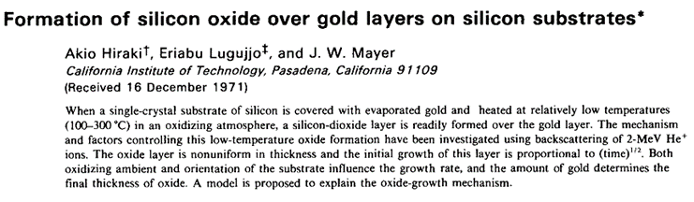
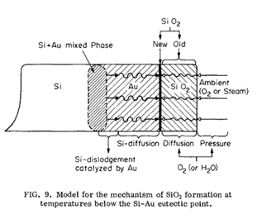
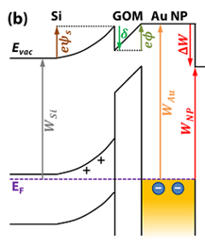
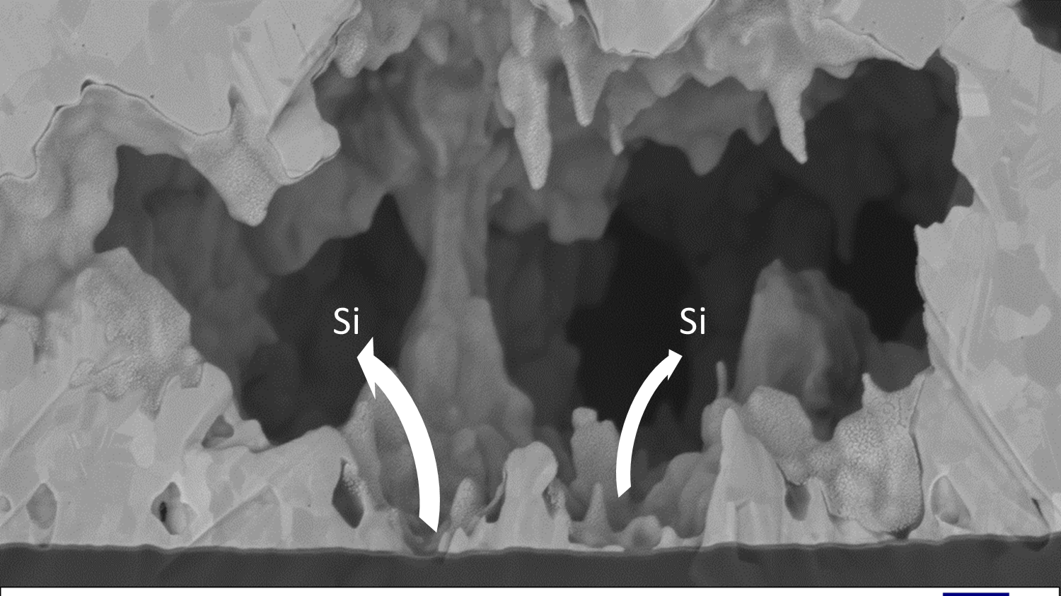
It’s a chain of rare or unknown events
Unlikely combination of Silicon-Gold intermixing leading to low temperature Silicon diffusion and subsequent E-field driven mass transport
2018
2021
Start-Up
Scale-Up
Temperature
Silicon Au Mixed Phase
Moisture
Catalyze Au-Si Mixing
Gold Migration
& Voiding
External pimple
No change in Resistance
E-field
Work Function
E-Field
Mass Transport
  Only one obscure 1971 paper on sample accidently was left overnight in sputter chamber
1971
  Gold and Silicon are rare and forbidden combination in CMOS land so very limited information
  No detection at DC wafer probe
  but intricate impact on RF performance
  Complex concatenation of rare and unknown material interactions leading
  Dedicated concurrent program between customer and supplier resolved the issue at a manageable delay
Notes:
Because it’s a complex chain of rare events.
Let me briefly explain.
This happened in Bias Damp Heat (BDH), also known as Temperature Humidity Bias (THB), or as operating 85/85 – referring to 85degC and 85% RH
At these low temperatures of 85degC and this humidity you already get Silicon and Gold intermixing.
This was discovered by serendipity at best in 1971 buy a guy who accidently left a silicon wafer coated with gold in a sputter chamber where the chamber wall was heated to avoid moisture build up.
When he came back the next morning there was a Silicon Dioxide, or Silica, layer on top of the gold – so how the hell did that happen ?
The Au-Si Eutectic temperature is around 363degC, still much higher then the sputter chamber temperature.
The only information we were able to find was this 1971 paper. As Silicon and Gold are not to be mentioned in one sentence, there is only limited information on this material system.
When biased, the tilit in the workfunctions proved to be a strong catalyser for the Silicon Gold intermixing and Silicon basically dissolving the gold.
Next in play was the E-field which gives the RF behaviour to the Co Planar Waveguide.
This ripped the gold literally apart by mass transport along the field lines to the ground electrodes.
This happened within the first 168 hour readpoint, no-one could predict that this dramatic effect would happen at such low energies.
It was the unlikely convolution of temperature, humidty, E-field and materials which made this happen, but which no-one could have predicted.
This happened when I was at Effect Photonics, before joining Smart Photonics where I am today.

Slide 4

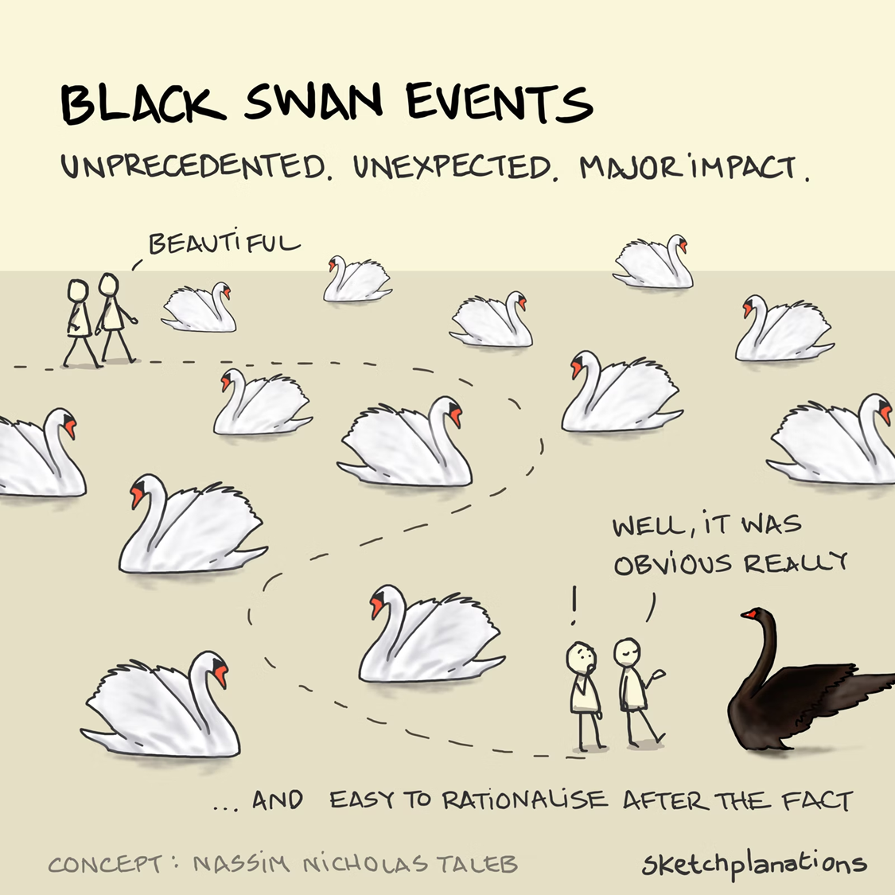
A “Black Swan” was a common expression in 16th century as a statement of impossibility.
However, in 1697, Dutch explorers led by Willem de Vlamingh became the first Europeans to see black swans in Western Australia.
The term subsequently metamorphosed that a perceived impossibility might later be disproven
Notes:
What I have given you was an example of a black swan.
A black swan is an event which cannot be predicted, has an extremely low probability, but when it happens it has a huge impact.
Only once it has happened, you are able to track back and explain why the Black Swan has happened.
The term Black Swan was popularised by Nassim Taleb (but I warn you that is book is not enjoyable) but has Dutch roots.

Slide 5

Complicated stuff ➔ busy slides ahead
1994
Timeline what happened:
to the company, technology and me
2022
Black Swan Example
Problem Hierarchy
  Problem Characteristics and impacts
Timeline scientific knowledge:
Compare with company timeline
Background illustrations
Notes:
I’m going to walk you back through my career where I brought a further 3 technologies from lab to fab.
To get a feeling for Black Swans, I’ll give you an example for each of these technologies
I will follow the same layout.
The timeline of the technology and the companies.
A summary of the hiearchy of the problem to illustrate the complexity

Slide 6
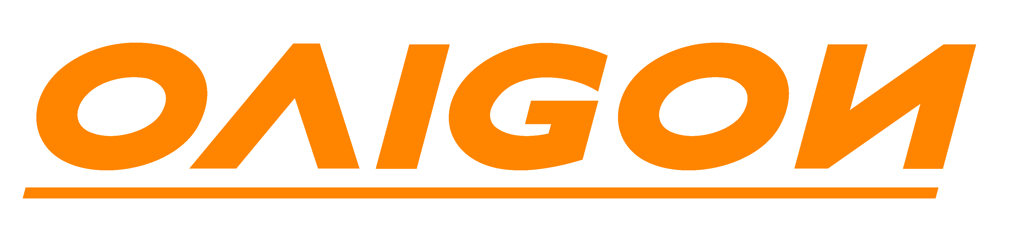


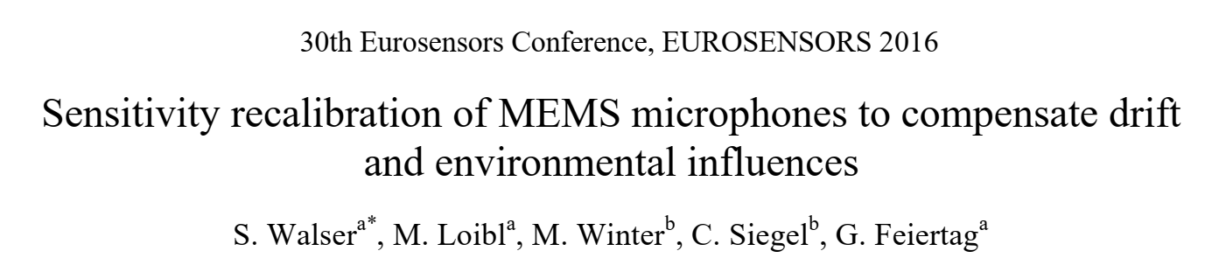
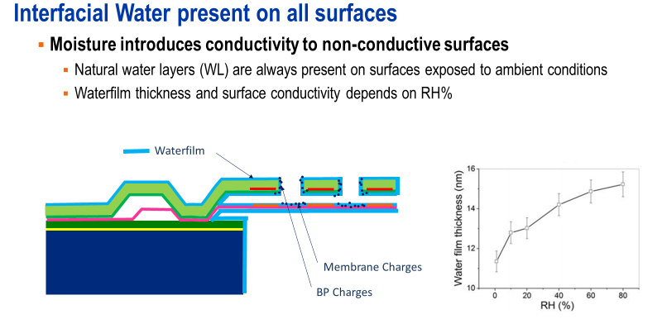
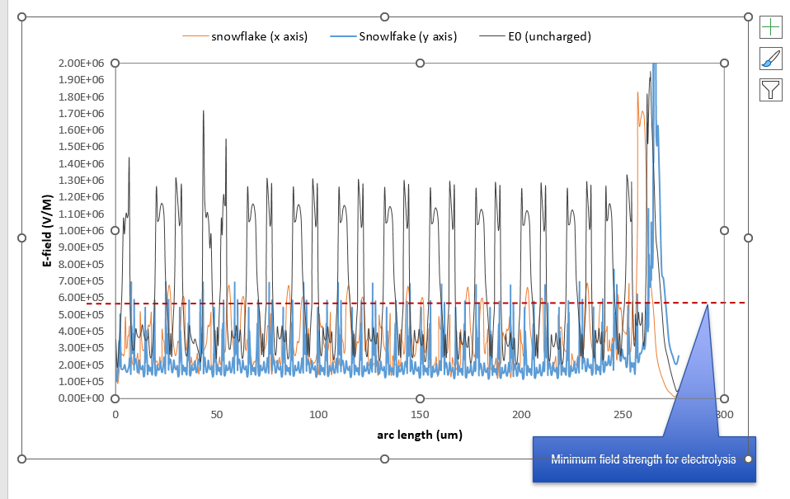
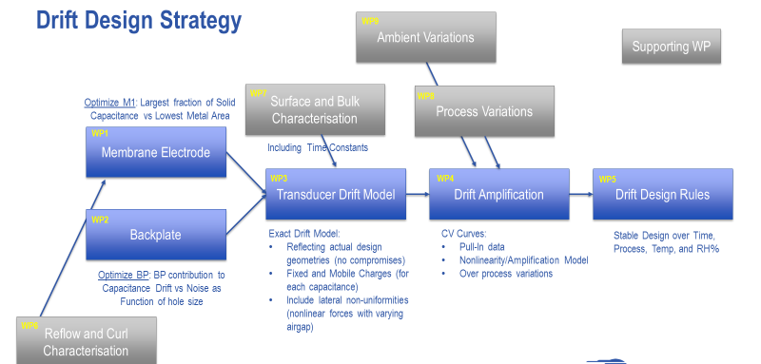
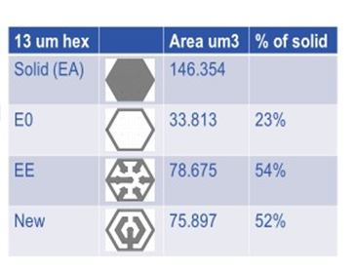
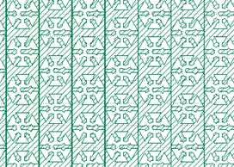
New Technology ➔ Unknown unknowns
2006
2007
Non-linear behaviour of fringe fields interaction with charge trapping in thin-film Silicon Nitride and Surface Water Layers in capacitive sensors leading to multiple drift mechanisms
2014
Start-Up
acquisition
acquisition
MEMS Microphone Design
Nonlinear Fringe fields
SiN Charge Trapping
E-Field Redistribution
nm level Creep
Microphone
Sensitivity Drift
Atomic Waterfilm
Metal
Ductility
  Similar issues not described in scientific literature, only appearing in 2016
2016
  Unexpected atom level interactions impacting on a macroscopic level
  Huge impact on the design complexity to meet opposite requirements and resulting delays
Electrolysis
SiN Hydrogenation
  Created many concurrent options leading a successful technology
Edge Curl
  Product line was divested in 2021 and acquired by competitor
Snowflake
Notes:
I’m working back in time, so this is about 10 years ago.
I was working in the consumer electronics space for smartphone sensors and chips, so if you have an Apple, Samsung or Motorola you most likely have a chip of me.
Prior to Effect Photonics I was involved amongst others in developing a monolithically integrated CMOS-MEMS sensor.
This meant technology transfer to the likes of Magnachip, UMC and TSMC.
That was rollercoaster ride, there appeared to be so much unknown of the CMOS process which was relevant for sensors
Exposed to ambient conditions, having strong free-space electric fields it was like opening Pandora’s box.
Completely unexpected because the assumption was that CMOS processes were well developed and understood.
But mechanical properties, interface work-functions, hydrogen, non-linear e-fields at angstrom displacements are a small selection of the issues
The design and process space became very rapidly enormously complex.
This gave a 2+ years delay, but ultimately we cracked it and introduced:
many CMOS process improvements
New Design methodogies
This included a patented snow-flake design
Also the process impovements and understanding greatly benefitted the CMOS lines in TSMC, UMC and Magnachip
Note this was not the only one, there were multiple Black Swans we had to deal with

Slide 7




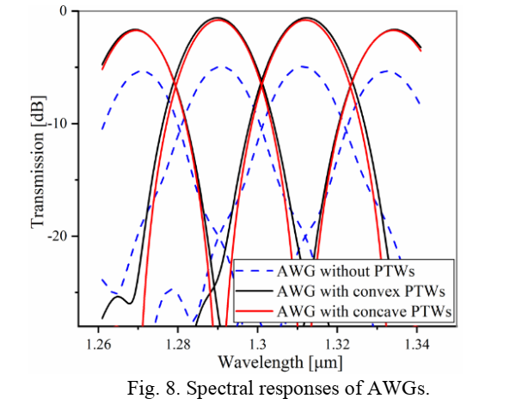
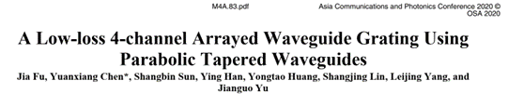
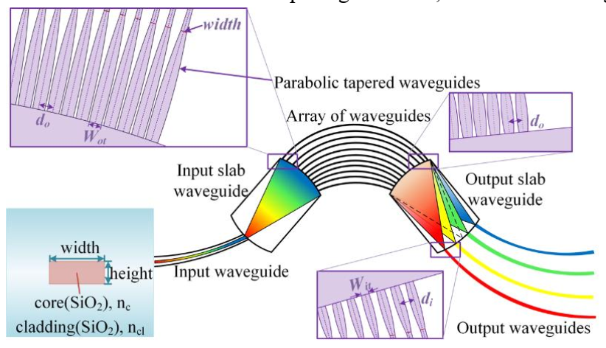
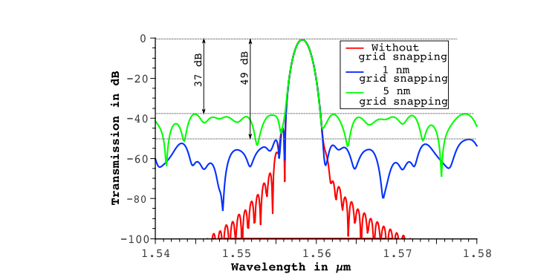
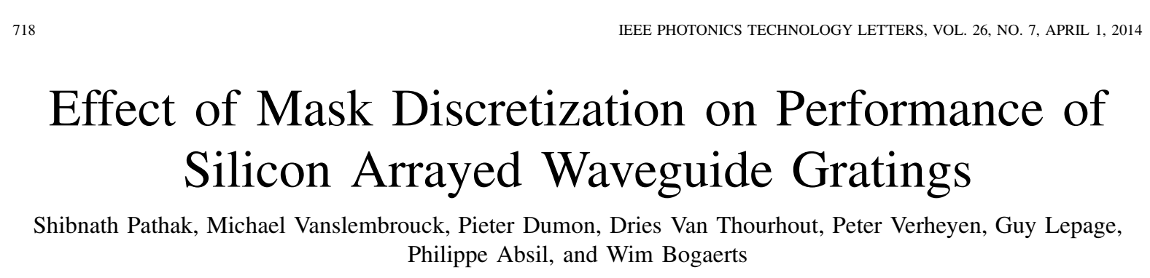
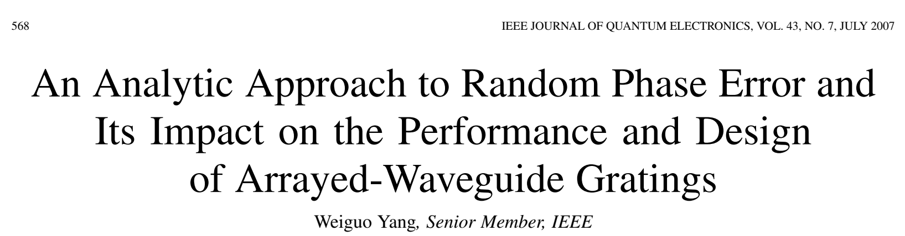
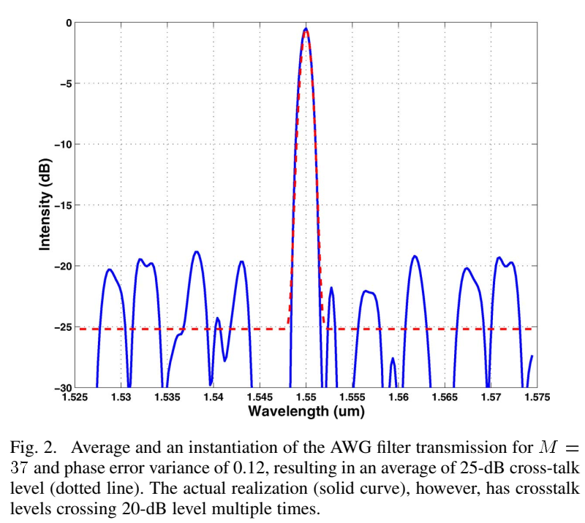
New Technology ➔ Unknown unknowns
Decoherence of laser light due to local refractive index variations orders of magnitude below telecom wavelength of 1.5um (and also due EDA tools only drawing squares)
2000
2001
2003
(Now: )
Start-Up
acquisition
acquisition
AWG Design
Design
Phase Errors
Taper Mode Conversion
Digitization Phase Errors
Fabrication
Phase Errors
Cross Talk
EDA Grid Snapping
Random Phase Errors
  Similar issues not described in scientific literature, only appearing in 2007-2020
2020
2014
  Unexpected convolution in different domains contributing to the same performance issue
  Unexpected delays in meeting customer requirements by several years
2007
  Ultimately succesfull and still producing
Notes:
Going 20 years back in time.
This was the height of the telecom boom. We raised 168 million dollars – crazy stuff
We used that to build the worlds first 6inch fabs for manufacturing photonic chips and built three production cleanrooms in total.
Being the frontrunner this meant that we encountered many issues which were previously unknown.
Both is design methodologies, mask data processing and deposition processes
What made it particular difficult was that they contributed to the same detrimental performance parameter, this was cross talk
The investigations we had to do at the time did not appear in any literature until several years later.
And when checking for this talk, these subjects are still accepted for scientific publication.
So we could not have anticipated the encountered issues.
These were also some real Black Swans, and we had more than a handful of them.
Ultimately with several years delay these came to the market and are still being produced, and I’m told even in space.

Slide 8





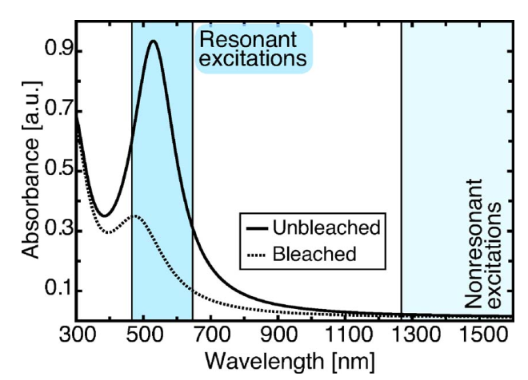
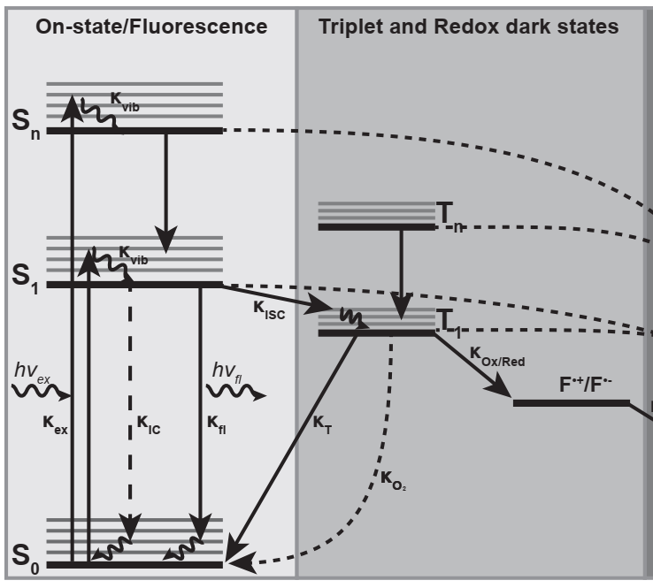
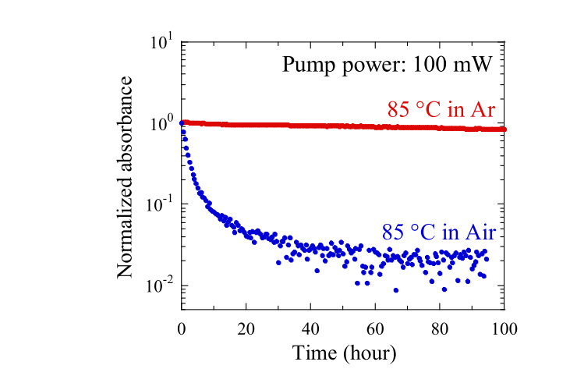

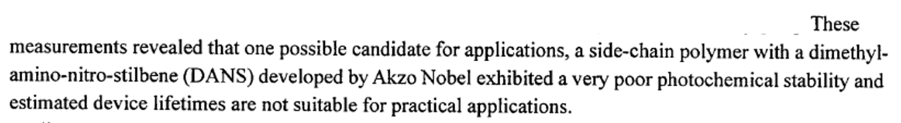
New Technology ➔ Unknown unknowns
1994
1998
1999
Triplet-triplet excitation by two photon absorption of oxygen at telecom wavelength of 1.5um in electro-optic polymer waveguides
Spin-Out
acquisition
acquisition
(Now: )
Functional Polymer Design
Two photon processes
High Intensity in Optical waveguides
Chromophore Degradation
Unstable in Oxygen Atmosphere
Vacuum Packaging
Singlet Oxygen
EO coeffictient Degradation
  Similar issues not described in scientific literature, only appearing in 2004-2021
2009
  New application at telecom wavelengths triggered unexpected mechanisms in polymers and only recently published
van der Velde, J. H. M. (2016). Intramolecular triplet-state quenching as a general method for
photostabilization. Rijksuniversiteit Groningen.
2016
  Complex convolution of previously unknown behaviors caused polymer degradation
Refractive Index Degradation
  The delays and cost increase resulted in cancelling the functional polymer development for telecom
2021
  The same issue had to be addressed for OLED displays
Notes:
Okay, the last example is from 30 years ago.
Time flies and this was my first encounter with Black Swans – Big Time !!
At least that’s what I thought, more on early Black Swans at the end.
AKZO NOBEL wanted to diversify their polymer design know how into different markets.
We had three projects: DVD-R, Display Films and Electro-optic Polymers.
The example here is about the EO polymers, The polymers we engineered to have very low loss at the telecom wavelength of 1.5um
Molecular oxygen has a triplet ground state (3O2) and is present at millimolar concentrations
This turned out to be the major cause for photodegration of organic fluorophores.
Energy transfer from the triplet state towards oxygen via triplet-triplet annihilation leads to the formation of excited singlet oxygen (1O2) and the fluorophore in the ground state
Additionally, molecular oxygen can directly react with the triplet state of the fluorophore causing an electron
So despite the low absorption cross-section and low triplet oxygen concentrations present, the high intensity of light in waveguides was enough to trigger this unlikely mechanism.
This was totally wrong, but there was no way on knowing that at the time.
The project was cancelled but publications on this topic are still happening 30 years on.

Slide 9

Technology start-up/scale up
A Technology Start-Up or Scale-Up has a high probability of “Black Swans”
  Based on 4 datapoints ;)
But “Black Swans” do not appear on a FMEA
  Random >5σ event
  Low RPN
  If predicted at all
I’ll share with you how to make Black Swans appear
Technology Start-Up
“New” Shiny Technology
Scale-Up
Statistics Kick-In
Black Swans
Can only explained in retrospective
Cannot be predicted well in advance
Extremely low probability
High Impact
Notes:
So what have we learned from the four examples I encountered in my career ?
The oldest one 30 years ago led to business failure
The telecom boom example 20 years ago led to 3-5 years delay of succesful market introduction
The CMOS-MEMS example in consumer electronics had 2-3 delay and the technology is living on
The first example with Effect Photonics was solved within a year
So you see that I improved on Black Swans about every decade
In all cases there was no way that we could have predicted the issue.
Only after fundamental investigations we understaood the complexity of the failure modes involved
This complexity leads to a very low probability and very high impact
This impact included huge delays and cancellations
So these are the characteristics of the Black Swans, which kick in when you scale up your technology to volume production.
I will share my secrets with you how to successfully deal with Black Swans

Slide 10

FROM LAB to FAB
Risk management in a technology start-up/scale-up
Tsjerk Hoekstra 15-09-2022
Notes:
After this extensive introduction, I can now start with the presntation

Slide 11
Notes:
I’m with Smart Photonics.
It’s history lies in innovative technology developed by Philips Research and the TU/e
Since 2020 we have put a strategy in place to become a global leading foundry for photonic integrated circuits.
We call this strategy “From Lab to Fab”

Slide 12
10k
100k
1000k+
5σ events matter
4σ events matter
3σ events matter
Notes:
As we have seen, scaling up new technologies means volume scale up and the changing statistics going with that
As such we het in the realm where unpredictable events start to matter
A good tool to help dealing with these uncertainties is the Known-Unknown framework

Slide 13
Known/unknown risk framework
Knowledge
Known
Known
Unknown
Unknown
Known
Unkown
Known problems but unknown solutions
Unknown problems but known solutions
Unknown solutions to unknown problems
Known problems and solutions
Socrates
Notes:
The framework can help us to understand our approach to knowledge, to find out:
What do we know already (known knowns)?
Are we aware of our assumptions or do we ignore them (known unknowns)?
Do we know about biases and unconscious decisions (unknown knowns)?
Are we conscious of what we are not exploring (unknown unknowns)?

Slide 14
Recognizing the Known/unknown risks
Knowledge
Known
Known
Unknown
Unknown
Known
Unkown
Predictable
Ignorance
Extrapolation
Surprise
Socrates
Notes:
So we can say:
Known Knowns (facts): you use analytics data to check those facts against them.
Known Unknowns (hypotheses): should not be ignored - can be confirmed or rejected with measurements against a baseline
Unknown Knowns (our intuitions and prejudices): extrapolate data in an open-minded way so we can recognise patterns and hidden behaviour
Unknown Unknowns (it can be anything!): are often left behind, but can be prepared for as we will later see

Slide 15
Dealing with the Known/unknown risks
Knowledge
Known
Known
Unknown
Unknown
Known
Unkown
Predictable
Ignorance
Extrapolation
Surprise
Project Plan
FMEA
Socrates
Black Swan
The FMEA and Black Swans are intricately linked ➔
The FMEA plays a key role in dealing with the Unknown Unknowns
Notes:
So now we can assign methods to deal with each of these known-unknown categories
What is predictable, the know-knowns, we should include in the project plans
The known-unknowns and the unknown-knowns should emerge from the FMEA
The remaining unknown-unknowns form our Black Swans
I’ll explain next how the FMEA and the Black Swans are related and important to each other

Slide 16
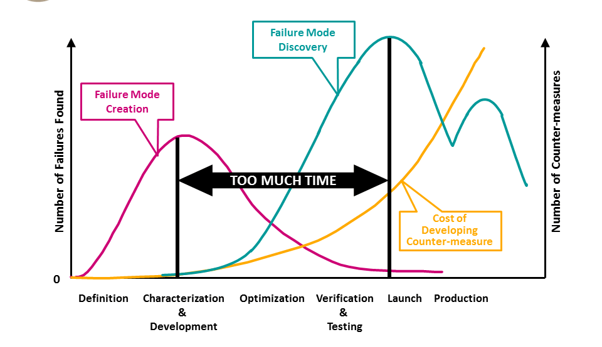
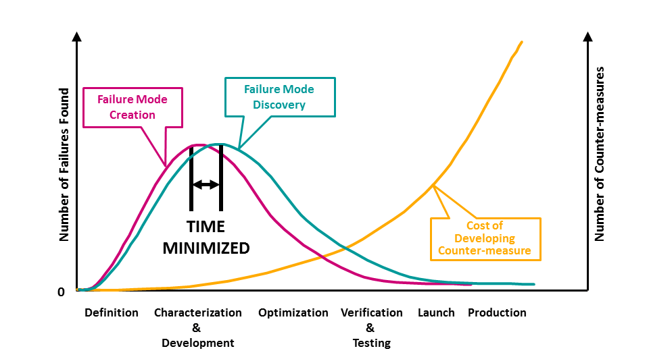
THE impact of the fmea
Poor FMEA let’s the known-unknowns & unknown knowns slip
Proper FMEA deals upfront with the
known-unknowns & unknown knowns
Adapted from: “A Failure Mode Avoidance Approach to Reliability” Anamika Saxena (2015)
Notes:
Now we established that black swans and the FMEA are connected, lets explore that further.
Let’s start with looking at the impact of the FMEA onto product development timelines.
Remember that the FMEA should identify the known unknowns and the unknown knowns.
If you do a poor job of conducting the FMEA, the failure mode escapes will pop up towards the product launch or ramp up.
This leaves no time or resources to correct the failure mode, only at great cost, if at all.
On the other end, a good FMEA will bring forward the discovery of the failure mode and the associated corrective action.
A good FMEA therefore will have a more limited impact on your project.
The resources required will be significant less than the escape of a known unknown, or an unknown known.
Okay, that leaves us then with the unknown unknowns.

Slide 17
THE effect of fmea on a black swan
Poor FMEA convolutes
Black Swan detection and resolution
Proper FMEA allows
resources for Black Swan
Black Swan Event
Black Swan Event
Black Swans appear during ramp-up and verification stage
Notes:
Now we can also plot the unknown unknowns.
By definition of low probability they appear when you are ramping up and do detailed characterisation.
So in the final phases of your project towards production.
If we have done a poor FMEA, the unknown unknowns appear at the same time as the known unknowns and unknown knowns.
It will extremely difficult to deconvolute these and your product development most likely will fail.
But if you have done a good FMEA, the Black Swans appear as an isolated event.
This will give you a chance in dealing with the Black Swan, but it will delay your product launch considerably.

Slide 18
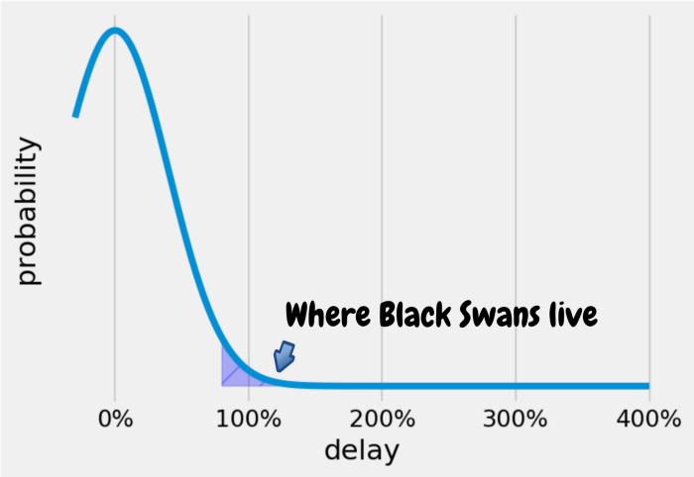
Black swans = delay
Due to the Unknown Unknown nature of Black Swans:
  They are in the tail of the probability
  Have not been planned for
  Solutions are not at hand
Delay
Notes:
There is no way around that the appearance of Black Swans will cause a significant delay.
This is purely due the fact that they are unknown unknowns and that we will have to develop a solution from scratch.
As we have seen the resulting delays can be easily measured in years.
In the next slide I will reveal, based on my 30 years of bringing new technologies to volume manufacturing.
You may rember from the introductionary slides that my first experience led to cancellation,
but that the later instances led to successful product introductions at increasingly lower delays.

Slide 19

Smoke out the black swans early
Fail Forward
Black Swan Event
Make Black Swans appear earlier ➔ Fail Forward
Use Minesweepers and Test to Destruction
Notes:
If you want to remember only one thing from my talk, it is this one: FAIL FORWARD
Go actively out in the dark to go looking for Black Swans.
Even when the design or process is not ready, start making samples as if it is the final product.
These samples are typically known as MINESWEEPERS.
It’s important that you make larger quantities of the same design or product.
Put this through all the steps you would do to qualify a product, and worse: TEST TO DESTRUCTION
The parameter to monitor is the survival rate.
For new technologies I assure you that you will find Black Swans
What this does is to bring the discovery of Black Swans forward, hence this is called FAIL FORWARD
That will buy you time to solve them and that they therefore will not take your whole program down.

Slide 20

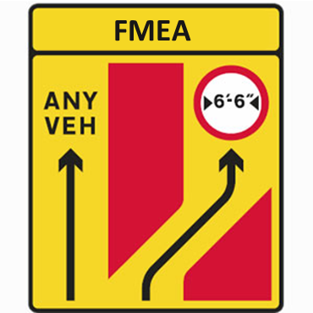
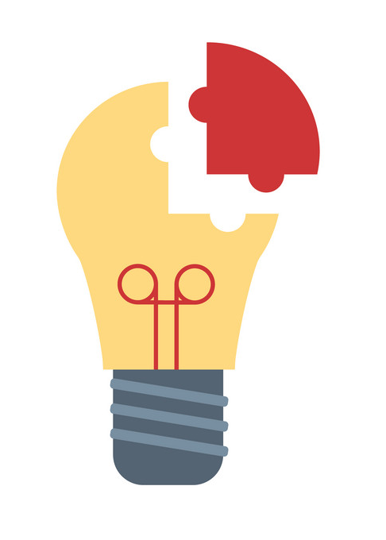


Building resilience
Anticipate unknown unknowns will happen
No Excuse
Use FMEA to separate & isolate unknown unknowns from the rest
Build a problem solving team having engineers capable neutralising black swans
Build a constant baseline using to facilitate problem solving
Fail forward (minesweepers) and test to destruction (red flag testing)
Notes:
From here the key to be able to survive Black Swans is to Build Resilience in your planning and your team.
Because you have to accept that unknown unknowns WILL HAPPEN !!
The FMEA has more purposes, on which I will come back.
But we have seen that the FMEA will deal with the known unknowns and the unknown knowns, so only the unknown unknowns are left to solve.
Next important thing is build a problem solving team, hire the brightest and most creative you can get, especially if they have a quirk of some sort.
You can’t identify the problem without having a baseline, so having a lot of DOE’s in the line is killing.
And my favourite, fail forward and test to destruction. This means that you don’t stop testing until you have induced the onset of a failure. The you have to understand that failure and work back from there if this is a Black Swan

Slide 21
Why IT IS so difficult
Problem Prevention is Invisible to Management
Building a proper FMEA
takes time and effort
Focus on solving quality issues:
“What Went Wrong ?”
Problems remain hidden in many design & process iterations
No-one believes that they make mistakes
Notes:
That is a lot of common sense in the previous slide, but there are some very common reasons why this is very hard to execute in a company
Being aware of these may help you in getting attention from your management and colleagues it deserves
First of all, if you catch a Black Swan and saved the project from a 2 year delay, then no-one will notice – unless you tell them
Secondly building a good FMEA is essential but also requires proper attention and support
If you deliver poor FMEA’s the interest in conducting FMEA’s will fade because there is no merit from it
Management is typically more interested in solving visible issues and demand daily progress updates as a measure of action
In the US we would say “Spinning the Wheels” – a lot of noise and action, but zero progress
The best way to hide Black Swans is to be swamped with many single datapoints from experiments, iterations and DOE’s leaving yourself without a baseline.
Lastly, in a development project somehow no-one thinks there are issues and that magically everything will happen according to plan.

Slide 22
Apply AGILE & Concurrent engineering
Traditional Project Management cannot deal with Black Swans
  PERT, PRINCE etc is useless against Black Swans
What we need is built-in Flexibility while keeping a Baseline:
  Deliver functional devices to test early (fail forward)
  Establish safe fall back positions (to limit delay)
  Create Options to move to a different track (create an escape)
1. Fail forward
Design 1a
Process A1
Test
2. Fall Back
Design 1b
Process A1
Test
Design 1c
Process A2
Test
3. Escape
Design 2a
Process B1
Test
Notes:
We have already seen that project management and FMEA cannot deal with Black Swans.
As explained, we can be prepared for them by adding fall-back positions and escapes into the project plan.
All my projects at Effect and Smart Photonics are built like these, and served the companies very well – although they won’t notice that I have saved them ;)
Although this common sense, often this get’s a label as a hybrid between Agile and Concurrent Engineering methods

Slide 23
Evangelizing fmea at smart
Make FMEA official part of the Phase-Gate Business Process
Provide enough time to the Engineers for the FMEA sessions
Limit Scope, separate
X-FMEA where
X = U, D, P, ....
Celebrate reaching FMEA approval
Be prepared and discuss details, it’s not a brainstorm
FMEA Team to Present Top 5 Risks to Management
External training on FMEA and resulting Control Plans
Make it result in a Control Plan and tangible changes of the Design/Process
Make FMEA session inclusive of those hands-on on the floor
Notes:
So it is really important to get FMEA on your companies agenda, if not already there.
I’d like to talk you through on how we approached this at Smart Photonics.
As you have seen I have experienced many companies, and I am genuinely impressed how well this is running at Smart thanks to my colleagues.

Slide 24
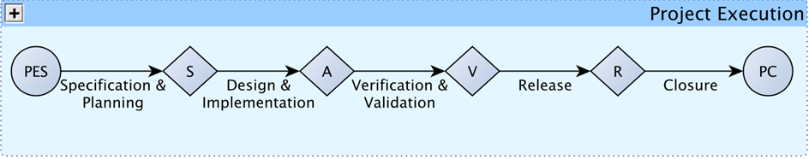
Fmea in smart Business process
Make FMEA official part of the Phase-Gate Business Process
Notes:
First of all it starts with a phase-gate business process of some sort.
At Smart we looked at NXP for inspiration and adapted that for our specific circumstances.
In our case the A-gate cannot be passed without an Approved FMEA and Control Plan

Slide 25
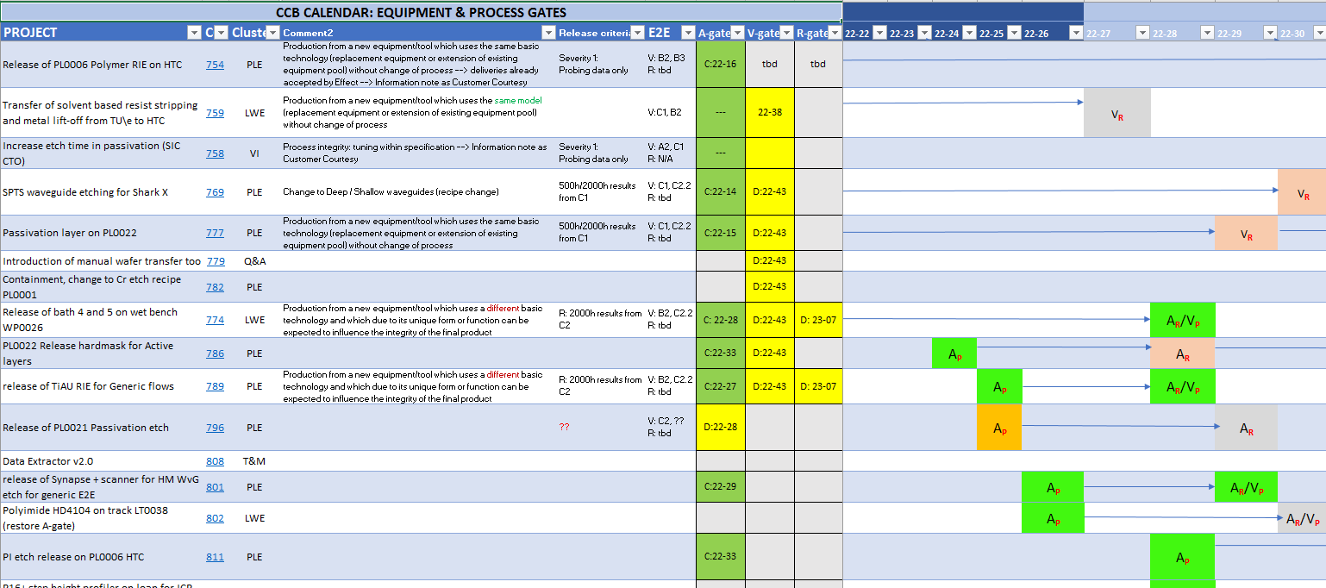
Tracking fmea through gate review
Make FMEA official part of the Phase-Gate Business Process
Notes:
At the Change Control Board (CCB) we review, approve and track the A-gates, and therefore the FMEA is fully tracked

Slide 26
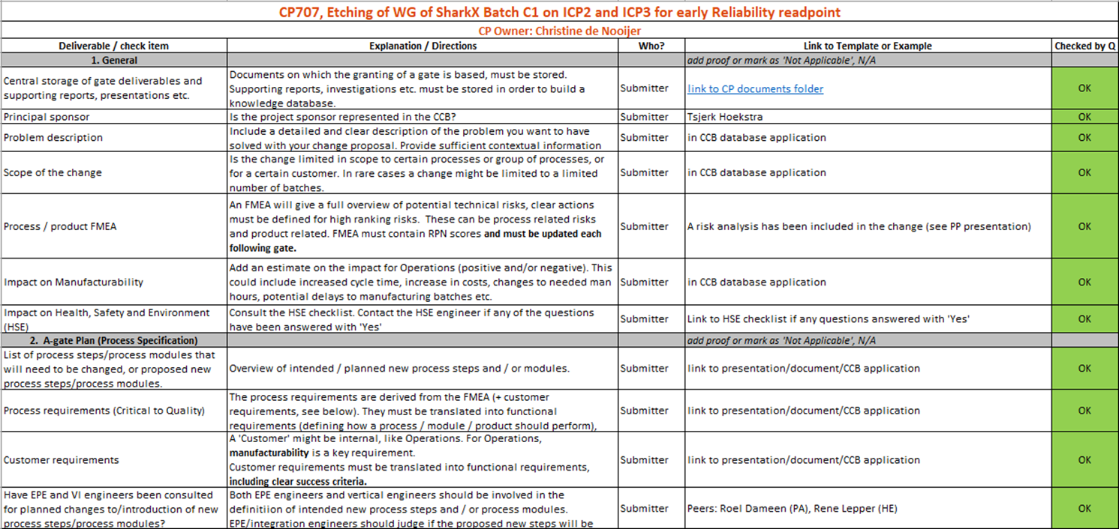
checking fmea through gate review
Make FMEA official part of the Phase-Gate Business Process
Notes:
The CCB A-gate cannot be held if the FMEA is not singed off by peer-review and by the CCB Chairman or Quality Engineer

Slide 27
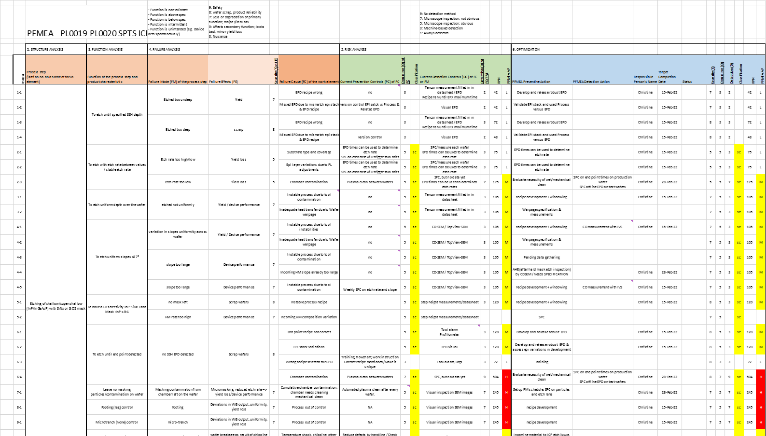
Make FMEA serious & important
Provide enough time to the Engineers for the FMEA sessions
Then it will be seriously treated by the engineers
Be prepared and discuss details, it’s not a brainstorm
Make FMEA session inclusive of those hands-on on the floor
Notes:
Our FMEA’s are pretty comprehensive and takes several meetings to complete, especially with a focus on known unknowns and unknown knowns
We will take later a closer look at one the items on this comprehensive FMEA

Slide 28
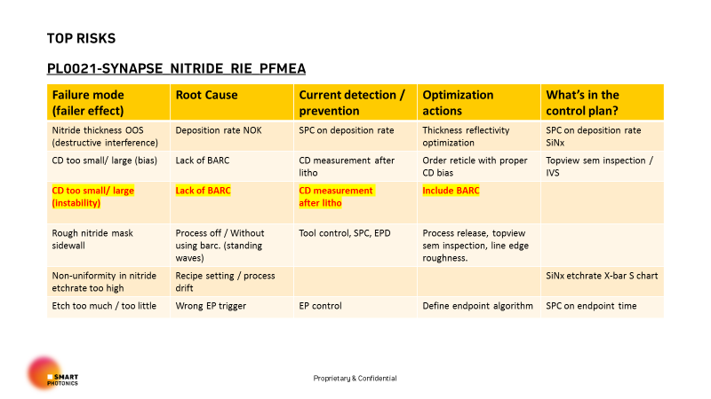

Management team buy in
FMEA Team to Present Top 5 Risks to Management
Full FMEA checked by Peer review and Quality Engineer
Top 5 presented to CCB which includes members of the Management Team
Celebrate reaching FMEA approval
Congratulations
CCB Chairman
Notes:
At the CCB, which must have a certain numbers of LT members present.
The top-5 risks are presented and discussed with the MT to establish how well the FMEA has been conducted.
The most important part is a traditional and genuine “Congratulations” from the CCB Chairman to the engineering team presenting their A-Gate to the CCB

Slide 29
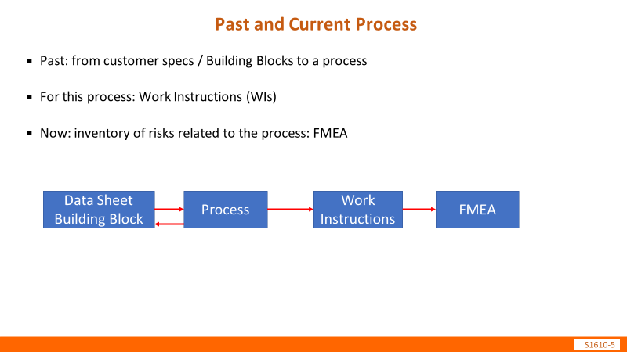
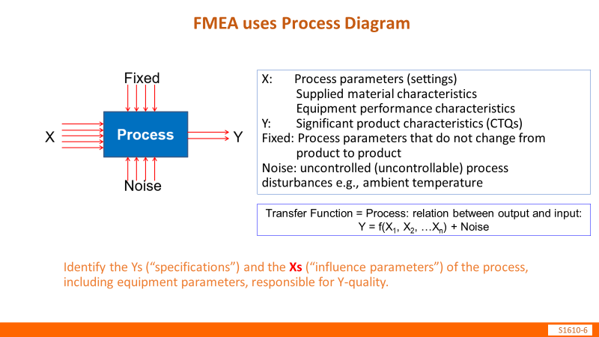
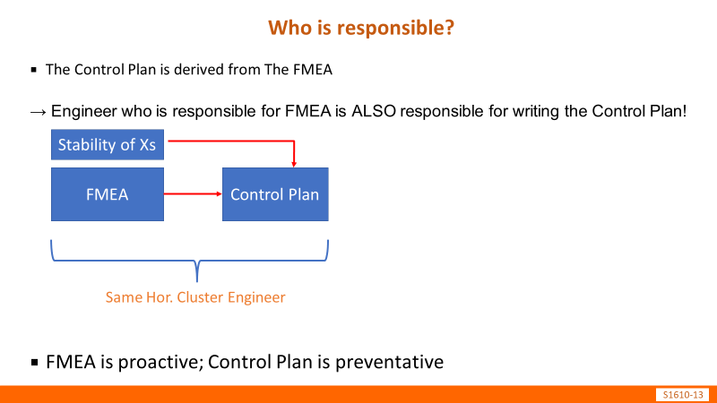
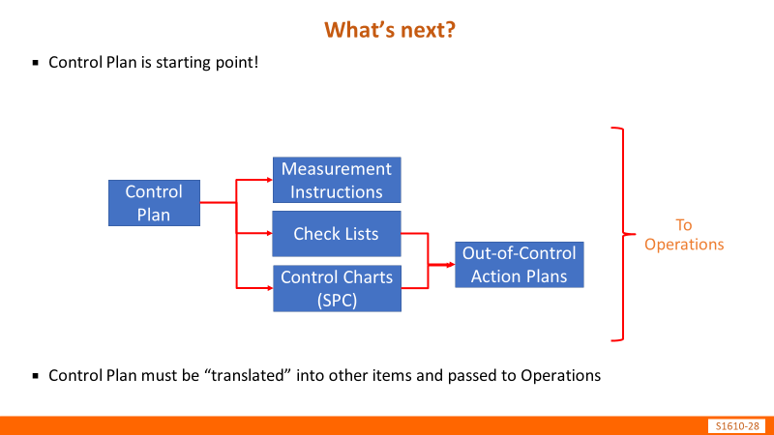
Dedicated training
External training on FMEA and resulting Control Plans
Make FMEA and Control Plan Training specific to your company
Notes:
We have asked our friends from Holland Innovative to prepare and present FMEA and Control Plan training to the team.
So we have a common playing field where all the engineers are aligned in conducting the FMEA

Slide 30
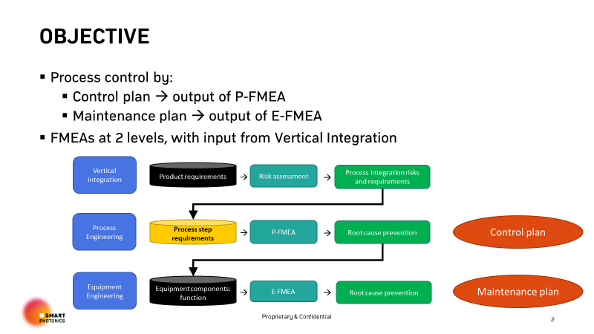
Fmea is not the output
Make it result in a Control Plan and tangible changes of the Design/Process
That would be an excuses list why the project will fail
Focus on Tangible Outputs:
  Control Plans
  Maintenance Plans
  Design for X
Have Tangible Owners:
  Process Integration
  Process Engineering
  Equipment Engineering
Notes:
Further it is key to have the FMEA to provide tangible output and have tangible owners.
These tangible outputs are also tracked at the gate reviews, and specifically include Control Plans, maintenance Plans and Design Rules.
This makes a real difference compared to consider the FMEA itself as the key output

Slide 31
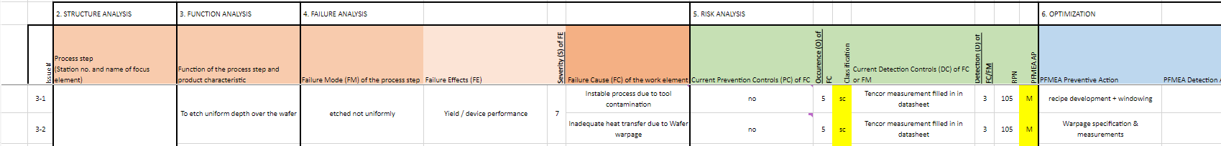
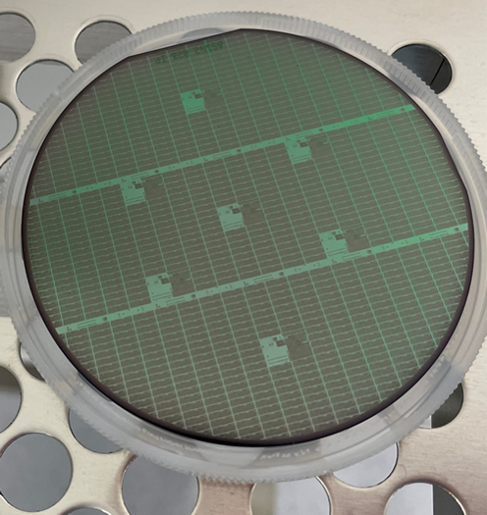
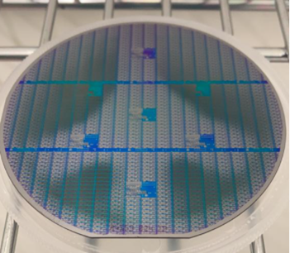
Not in My fmea (NIMF): ICP ETCH example
Brand New ICP
Test Wafer
Uniformity
Product Wafer
Mineweeper
?
Notes:
Now looping back onto an example where the FMEA didn’t catch an unknown unknown. I invented a new acronym for it: NIMF – Not In My FMEA
We have a brand new ICP etcher here, we have done a lot process development to get an uniform etch on test wafers and short loops and got a really great results.
Then we processed as soon as possible a full blown minesweeper through that process.
And here you see the result on the right.
So another question to the expert audience – any one seen this before or know what it is ???

Slide 32
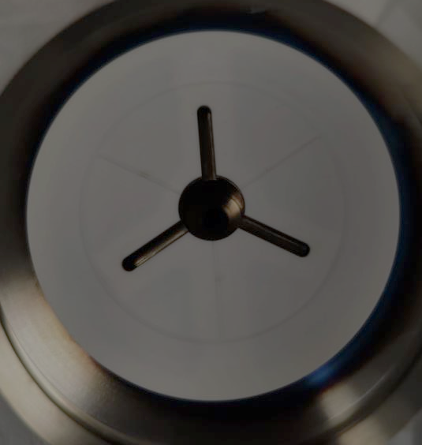
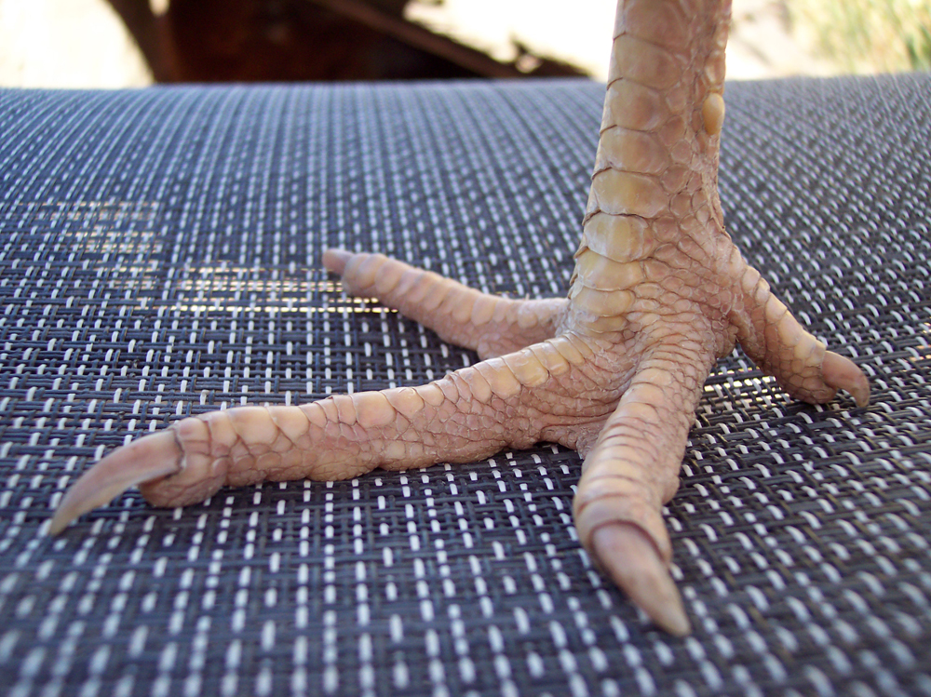
What is going on here ?
Internally this was called the “chicken-leg”
Mineweeper
1
1
4
1
2
3
2
3
4
2
3
Wafer Chuck
Notes:
So the chicken leg is characteristic in that it has FOUR toes
Obvious candidate was the wafer chuck of the ICP, but that has three legs
Any one any closer in understanding this mystery ?

Slide 33
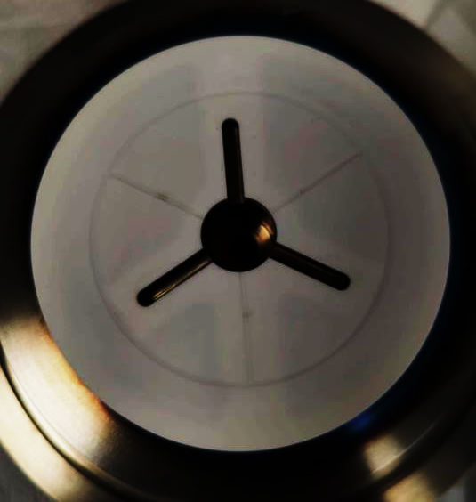
What is going on here ?
Internally this was called the “chickenleg”
Mineweeper
1
1
1
2
3
2
4
2
4
3
3
Wafer Chuck
Wafer Chuck
Okay – This is at the bottom of the wafer, why is it on top of the wafer ?
Notes:
We tried different illuminations of the chuck, and now we could start to see a FOUR-toed pattern on the chuck.
But this is a the bottom of the wafer, whereas the non-uniformity is at the front of the wafer.
Anyone knows how the backside can be transposed to the top of the wafer ??

Slide 34
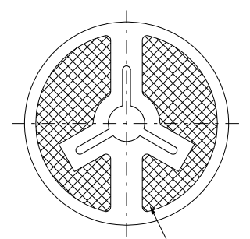
What is going on here ?
Okay – This is at the bottom of the wafer, why is it on top of the wafer ?
1
4
2
3
Wafer Chuck
Notes:
After pressing the tool manufacturer we got a sketch of the chuck, where the shape of the electrodes follows the tripod cut-out and resulting FOUR toed pattern

Slide 35
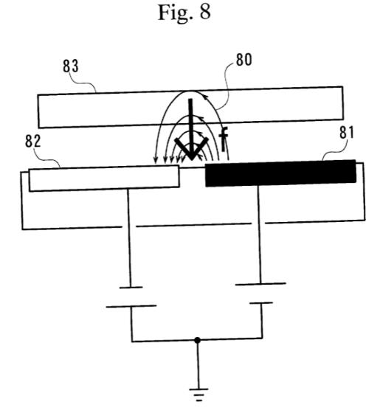
What is going on here ?
Okay – This is at the bottom of the wafer, why is it on top of the wafer ?
1
4
2
3
Wafer Chuck
It’s not the chuck itself, it’s the E-field from the clamping mechanism
Notes:
The next realisation was that the electrode forms field lines which is the actual clamping mechanism for the wafer.
The rest of the story is confidential.

Slide 36
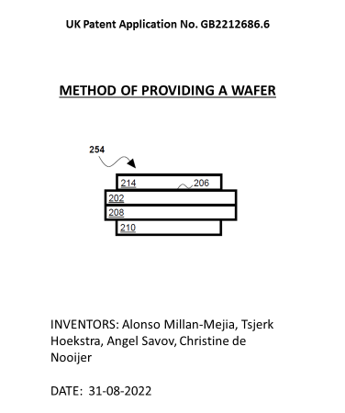
Problem solving team & minesweeper
No Delays
You Decide
&
In Any Case
Or
Unknown Known
Notes:
I’d like to see hands,
Firstly who thinks this is and Unknown Known ?
Secondly who thinks this is a Black Swan ?
In any case, the Minesweeper did it’s work and limited delays were incurred.
Secondly the solution to this problem generated a patent.

Slide 37
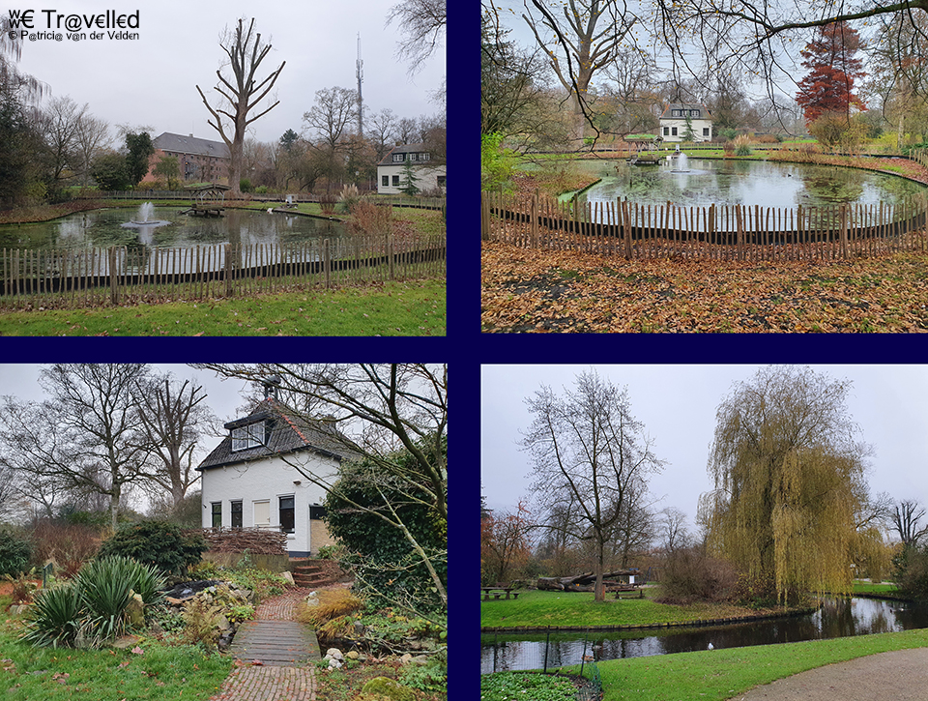
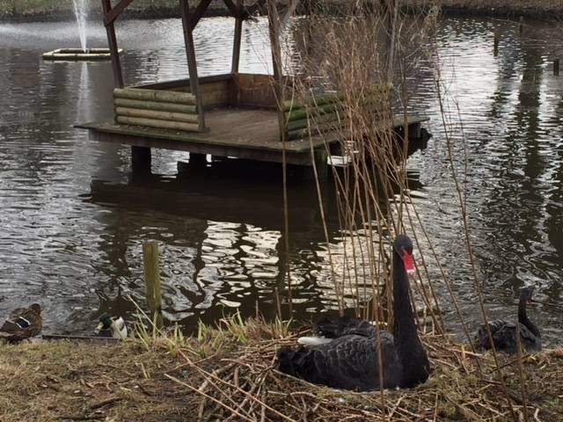
Interesting fact
I was raised in Wilhelmina Park in Sneek,
where my Grandpa was the park keeper
We had two Black Swans who had a very bad temper,
hence the fencing
Notes:
After writing this Key-Note, I suddenly had a realisation.
I partly grew up in a public park in Sneek, which is in the North.
My GrandPa was the Park Keeper and we lived in the Park in the Keepers House.
Among the many animals, there was also a couple of Black Swans.
They always had a very bad temper and you best to avoid them.
That’s the reason for the fence around the Swan’s Pond
So my realisation was that from young age I was familiar with keeping Black Swans at bay.
This beautiful Wilhelmina park is still there, as are the swans if you want to visit them.

Slide 38
Risk management in a technology start-up/scale-up
Serious investment in FMEA is essential
Use FMEA to catch
Known Unknowns and Unknown Knowns
But be Prepared for
Unknown Unknowns a.k.a. Black Swans
Build Resilience, Fail Forward and Flexibility
into your Team and Planning to deal with the Black Swans
Notes:
That brings us to the end of the presentation,
and some key take aways to manage risks in transitioning a new technology to volume production
To be successful in a “lab to fab project” here is the short summary.
And …. If you solved a Black Swan …. This is by definition a patent because these are Unknown Unknowns !!
With that I like to thank you for listing to this 30 years of experience with Black Swans and FMEA’s

Slide 39
Thank you
Tsjerk.Hoekstra@smartphotonics.nl

